Slide 1
MCS 366
Technology & Communications
E-Identifier
Crowdsourced criminal evidence identifier
Tony Lu

Slide 2
About E-Identifier
A crowdsourced web app allowing users to help police and law enforcements identify people and evidence that can lead to the arrest of the assailant and the rescue of any victims.

Slide 3
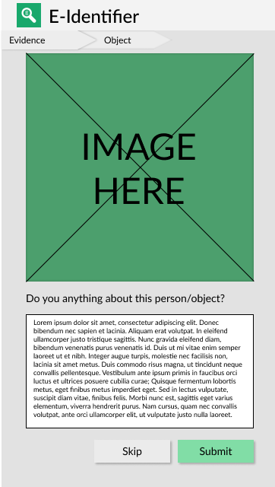
App Mockup
1
Categorized
1
The top navigation will show all known information about the specific object/person.
2
2
Images
Image(s) of the object/person for the user to review.
3
User Input
Users provide any information they may have about the image such as brand, location, etc.
3

Slide 4
Does it work?
Crowdsourced – any registered user can submit info
Lessens the work of law enforcement
Straight to arresting
Rewards (?)
Small prize if leads to arrest
Points to redeem
Multilingual / Worldwide
Linked across police/law departments

Slide 5
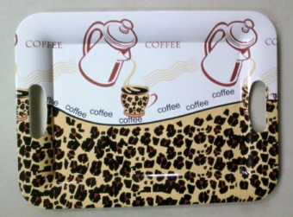
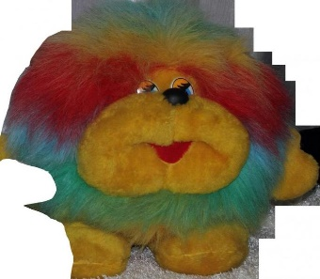
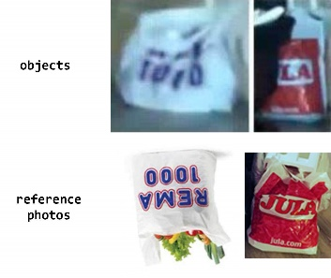
Why?
BEHIND THE IDEA
Europol: EU’s law enforcement agency
Stop Child Abuse – Trace an Object
Crowdsourced effort to stop child abuse
Users help identify objects in child abuse evidence
Submitted information can lead to the arrest of the offender and the saving of the victim
Read more:
https://www.europol.europa.eu/stopchildabuse
https://www.bellingcat.com/news/uk-and-europe/2017/08/28/stop-child-abuse-2nd-update/
4

Slide 6
MCS 366
Technology & Communications
E-Identifier
Crowdsourced criminal evidence identifier
Tony Lu

