Slide 1
“Moment Quote”
By: Nicole pagan

Slide 2
What is “moment Quote”?
“Moment Quote” is a touch screen machine with a keyboard attached to it. It can be installed in public places for anybody to use. The social issue to be resolved with this idea has to do with the emotional/mental state of a person and their own problems.
“Moment Quote” gives them a relatable quote depending on their situation/issue based on the information they give the machine. The machine has a large library of quotes from different writers, poets, entertainers, activists and more.

Slide 3
How does it work?
The way it works is that a person goes up to the machine and it asks them, “How are you feeling at the moment?”. The person answers truthfully and the machine replies to them, “Why is that?” then the individual could use the keyboard to write their answer. Their answer will flash on the blank screen for a second before disappearing and then the machine will choose a quote to display to the individual.

Slide 4
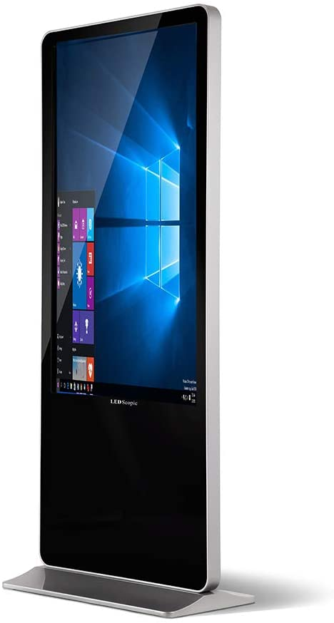
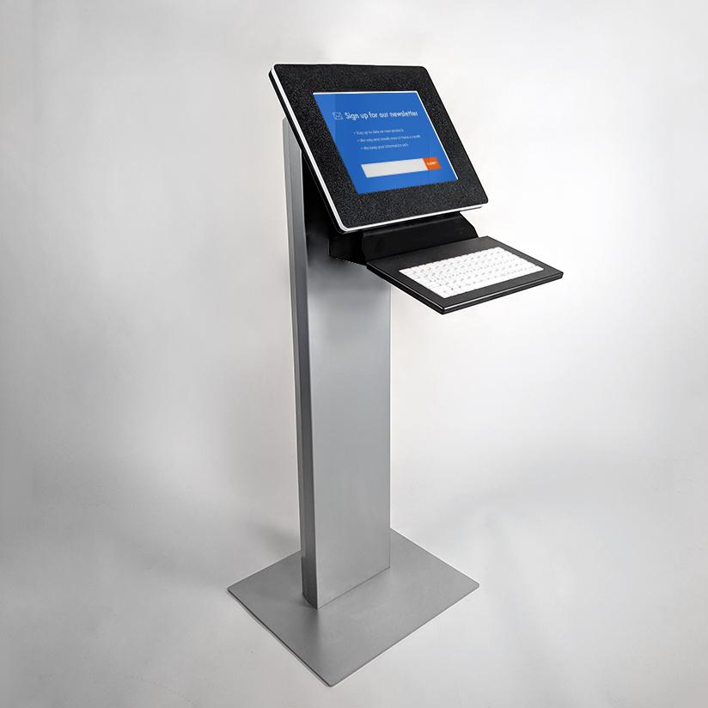
How does it look like?

Slide 5
The end

