Slide 1
Watcher
The Watch That Watches Over You
By: Nicole Lingayo
With this technology, it will help prevent rape. You will not become a victim. You become a fighter.
With this project, men and women can go to a bar with a harmless weapon, the Watcher.
It can lessen rape and sexual assult. The app also educates what is rape, and shows laws agaisnt it.

Slide 2
Watcher Features
Portable Swab: collect DNA.
Inside the watch, it has this tiny storage that can preserve DNA.
Why: it can identify the offender
Glass Screen: it can identify if your drink is drugged if you put a droplet in the screen. The screen will darken and it shows in the app what kind of drug is in your drink.
911 Alert: If you tap it multiple times, it will alert the police closest to you and send your location. It will also make an alarming sounds that can catch someone’s attention in the next couple rooms.
Mini Taser: if you press it on the offender, it will tase them.

Slide 3
APP FEATURES
911 Alert: Can customize how many taps on the middle of the screen to call 911
You can also turn off or on the features whenever you want.
It has help service feature: tells you what to do if you are a victim. It has trauma serve.
Mini Taser: change the levels of the taser.
Can be light, mild, or extreme.
Glass Screen: customize what color the screen can change to. It can identify the drug.
WATCHER
Portable Swab: preserve DNA. It can also analyze if the partner has STDs

Slide 4
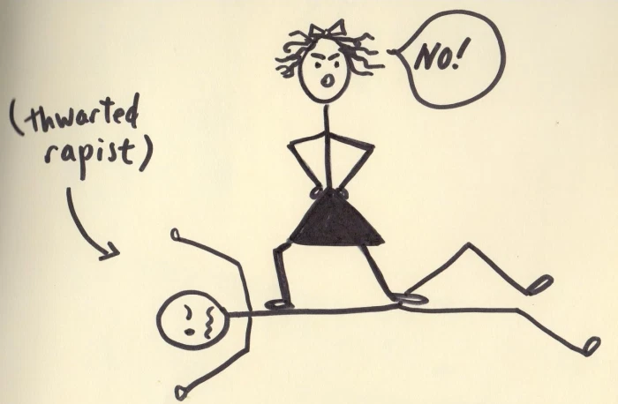
If a young girl/boy learn how to read the time, it is time for them to know what is sexual harassment and rape.
The app has features that shows them that they can say no. It also emphasize what is protected sex and the aftermath of sex.
If teenagers are knowledgeable about it, they can avoid teenage pregnancy.
They can protect themselves from predators.

Slide 5
WATCHER
BY: NICOLE LINGAYO

