Slide 1
Microchip implant

Slide 2
How does it work?
Small implant that allows people to catch diseases earlier then normal
Scans the blood stream to detect any potential dangers or changes in the body

Slide 3
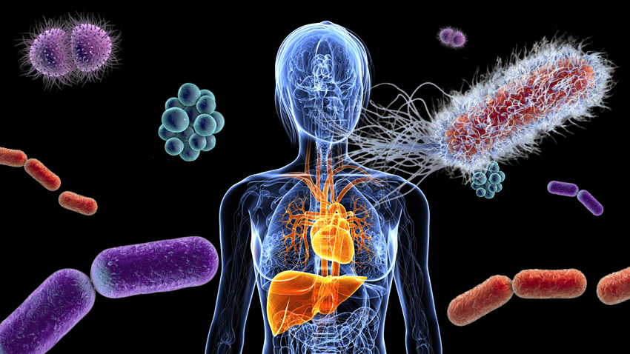
What type of disease will it detect
Detects all cancers at it’s earliest stages
Detects potential STD and HIV infections before symptoms appear
Any disease that effects the bodies immune system at an earlier rate then

Slide 4
Who will have access to this information
People will be able to download an app to keep track of their health
People primary care doctors will have access to this information to help patients with any concerns
The app will be available on all cellphone devices so individuals can view what’s happening in their body anywhere and anytime

Slide 5
Is it safe?
Privacy wise the information stored on the chip will only be accessible to the individuals and their primary care doctors
The implant will be inserted in the finger it will not cause any damage or disturbance to the body in anyway
It will not be detectable by metal detectors
Strong elastic material so it doesn’t break just incase one falls on their hands

Slide 6
Benefits
Early detection of any disease that enters the body
Able to fight the disease sooner before symptoms kick in
Could save millions of lives
Can detect HIV early enough to allow individuals to go to the doctors to take preventive medicine to stop infection

